Slide 1
Internet of Things
Notes:
Information in this document, including URL and other Internet Web site references, is subject to change without notice. Unless otherwise noted, the example companies, organizations, products, domain names, e-mail addresses, logos, people, places, and events depicted herein are fictitious, and no association with any real company, organization, product, domain name, e-mail address, logo, person, place or event is intended or should be inferred. Complying with all applicable copyright laws is the responsibility of the user. Without limiting the rights under copyright, no part of this document may be reproduced, stored in or introduced into a retrieval system, or transmitted in any form or by any means (electronic, mechanical, photocopying, recording, or otherwise), or for any purpose, without the express written permission of Microsoft Corporation.
Microsoft may have patents, patent applications, trademarks, copyrights, or other intellectual property rights covering subject matter in this document. Except as expressly provided in any written license agreement from Microsoft, the furnishing of this document does not give you any license to these patents, trademarks, copyrights, or other intellectual property.
The names of manufacturers, products, or URLs are provided for informational purposes only and Microsoft makes no representations and warranties, either expressed, implied, or statutory, regarding these manufacturers or the use of the products with any Microsoft technologies. The inclusion of a manufacturer or product does not imply endorsement of Microsoft of the manufacturer or product. Links may be provided to third party sites. Such sites are not under the control of Microsoft and Microsoft is not responsible for the contents of any linked site or any link contained in a linked site, or any changes or updates to such sites. Microsoft is not responsible for webcasting or any other form of transmission received from any linked site. Microsoft is providing these links to you only as a convenience, and the inclusion of any link does not imply endorsement of Microsoft of the site or the products contained therein.
© 2020 Microsoft Corporation. All rights reserved.
Microsoft and the trademarks listed at https://www.microsoft.com/en-us/legal/intellectualproperty/Trademarks/Usage/General.aspx are trademarks of the Microsoft group of companies. All other trademarks are property of their respective owners.

Slide 2
Abstract and learning objectives
Abstract
In this whiteboard design session, you will work with a group to design an implementation of an end-to-end IoT solution simulating high velocity data emitted from smart meters and analyzed in Azure. You will design a lambda architecture, filtering a subset of the telemetry data for real-time visualization on the hot path, and storing all the data in long-term storage for the cold path.
At the end of this whiteboard design session, you will be better able to design an IoT solution implementing device registration with the IoT Hub Device Provisioning Service and visualizing hot data with Power BI.
Notes:
This is an introduction to the Cloud Workshop at a high level. Later we’ll get into customer objections, requirements, etc… but we want to ground the participants on the business outcomes we’re going after for the day.

Slide 3
Step 1: Review the customer case study
Outcome
Analyze your customer needs.
Timeframe
15 minutes

Slide 4
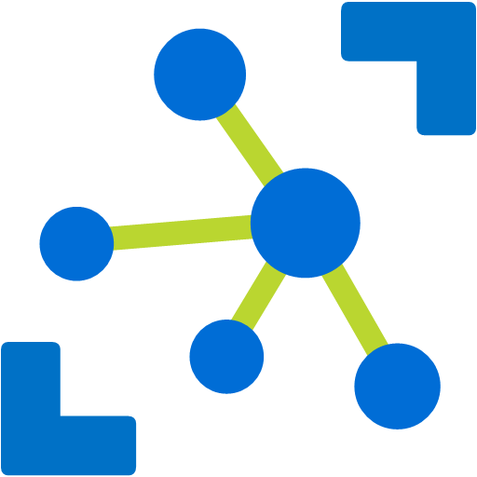
Customer situation
Fabrikam provides services, smart meters, and field gateways for enterprise energy management.
You-Left-The-Light-On service enables understanding of energy consumption.
Regulatory changes encourage upgrading offerings.
Want to be an authorized solution provider for City Power & Light’s “Smart Energy” program.
Notes:
Fabrikam provides services, smart meters, and field gateways for enterprise energy (electrical power) management.
You-Left-The-Light-On service:
Enables the enterprise to understand their energy consumption, not just as monthly totals, but with a more detailed breakdown providing kilowatt hours consumed by day.
Reports are used by the enterprise to identify operational patterns and address spikes that could be mitigated with better procedures.
Fabrikam provides printed reports that are mailed to customer enterprises on a monthly basis. However, regulations are changing and are encouraging Fabrikam to upgrade their offering and increase their market share.
City Power & Light (CPL), has an offering for enterprises that participate in their “Smart Energy” program that provides significantly discounted rates on electricity for enterprises that are managing their electricity consumption.
Criteria of the “Smart Energy” program center around the collection and analysis of detailed energy consumption data:
Telemetry data must be collected in at least 30-minute intervals.
The data needs to include a timestamp, the identifier of the device metered, and the energy consumed over the reporting interval.
Services report their telemetry to one of a few energy management solution providers authorized by CPL.
Providers store, process and tag the telemetry data on behalf of CPL, and provide reporting APIs that CPL can use to calculate awards and rebates.
Fabrikam would like to become an authorized energy management solution provider.

Slide 5
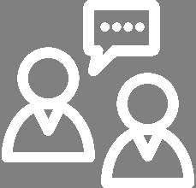
Customer needs
Need “hot” and “cold” data paths.
“Hot” path will process data in real-time.
“Cold” path executes nightly, processing and storing everything.
Single-screen visualization of data flow.
Want to understand how to scale the solution.
Notes:
We expect to have a “hot” and “cold” path of data.
The “hot” path will select certain data streaming in from the devices that we need to process in real-time to drive updates to the customer dashboard.
While the “hot” path may focus on a subset of the incoming data, the “cold” path will store and process everything.
Because the “hot” path provides the data for the current day’s operations, we only need to process the “cold” path on a nightly basis, our customers are happy with performing their analysis starting with the last full day of data—which is inherently yesterday.
We want a way to visualize our data flow, the steps taken on the data, and the status of our data flow on single screen.
We want to understand the ways in which we can scale the solution to accommodate future growth in terms of number of customers, meters, and the size of the data.

Slide 6

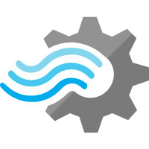

Customer objections
Does Azure offer a time series database?
Can Azure handle our volume of telemetry data?
Does Azure support a lambda architecture?
Are Azure IoT Solution Accelerators a good starting point?
Notes:
We are considering an out-of-the-box time series database solution. Are there options for this on Azure?
We have a mix of large enterprise customers and many SMB customers, which adds up to a lot of telemetry data to ingest—can Azure really handle it?
Can Azure handle a lambda architecture?
We have heard of Azure IoT Solution Accelerators – do these offer a good starting point for us?

Slide 7
Customer objections - 2
Some of our customers require their IoT devices to communicate in a firewall-friendly way without opening up additional incoming or outgoing ports. How do we accomplish this?
Notes:
Some of our customers require their IoT devices to communicate in a firewall-friendly way without opening up additional incoming or outgoing ports. What options do we have to accomplish this?

Slide 8
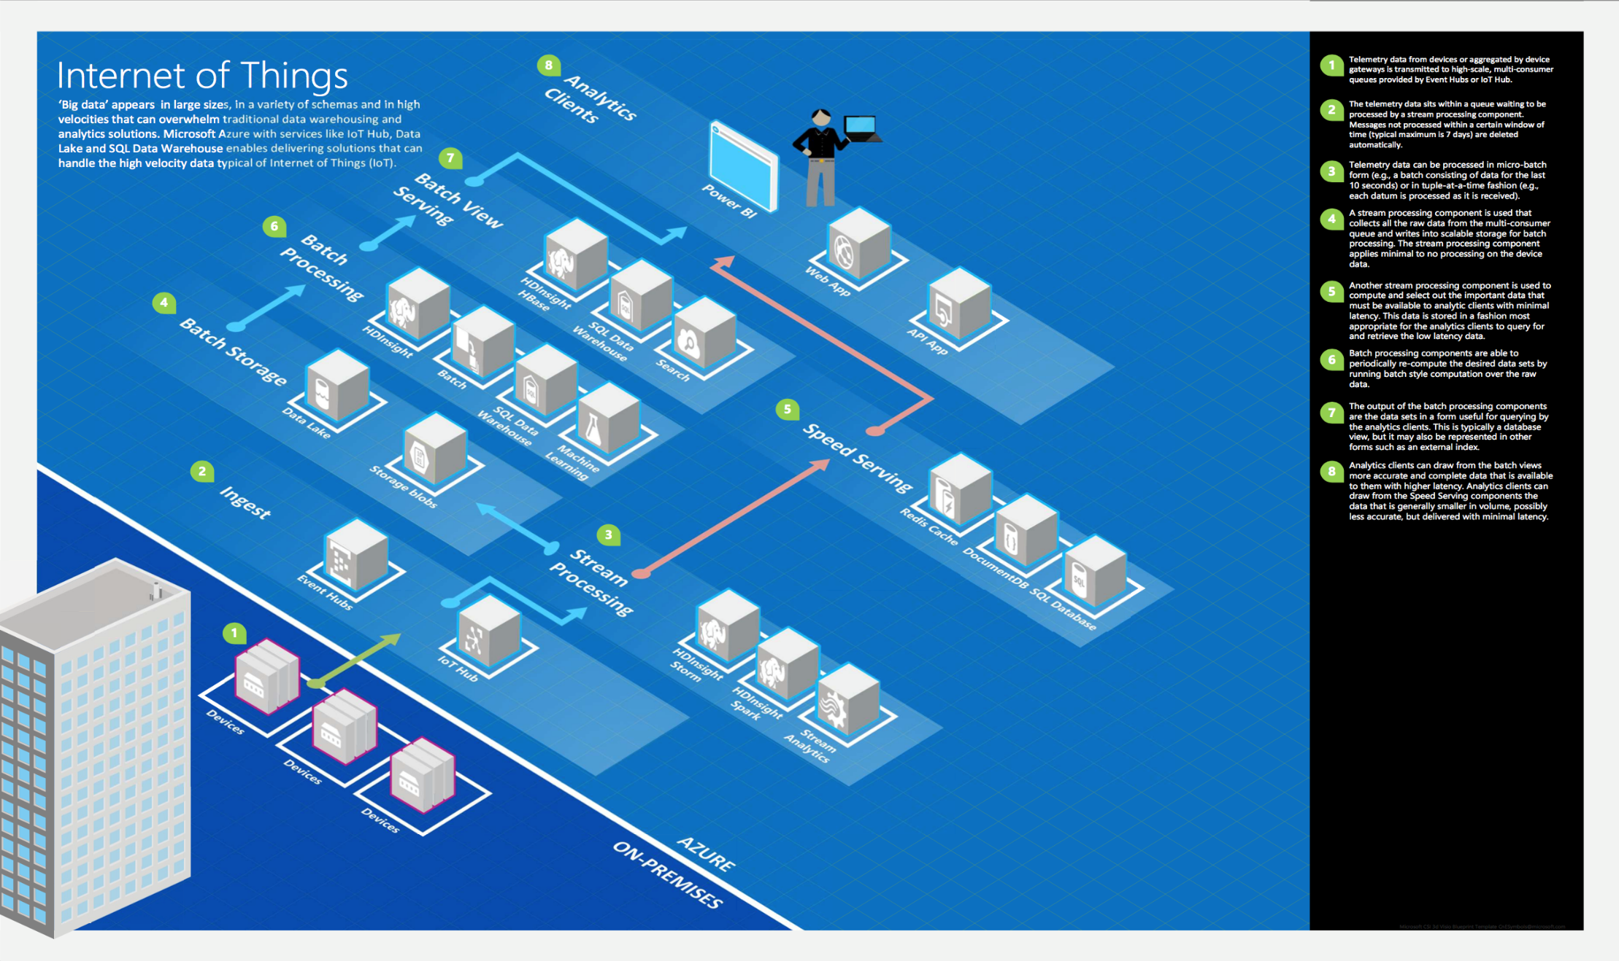
Common scenarios
Notes:
This is a diagram of a common architecture for this type of scenario, from which you can draw inspiration. You will find this diagram within the Whiteboard Design Session Student Guide.

Slide 9
Step 2: Design the solution
Outcome
Design a solution and prepare to present the solution to the target customer audience in a 15-minute chalk-talk format.
Timeframe
60 minutes
Business needs (10 minutes) | Respond to questions outlined in your guide and list the answers on a flipchart.
Design (35 minutes) | Design a solution for as many of the stated requirements as time allows. Show the solution on a flipchart.
Prepare (15 minutes) | Identify any customer needs that are not addressed with the proposed solution. Identify the benefits of your solution. Determine how you will respond to the customer’s objections. Prepare for a 15-minute presentation to the customer.

Slide 10
Step 3: Present the solution
Outcome
Present a solution to the target customer in a 15-minute chalk-talk format.
Timeframe
30 minutes (15 minutes for each team to present and receive feedback)
Directions
Pair with another table.
One table is the Microsoft team and the other table is the customer.
The Microsoft team presents their proposed solution to the customer.
The customer asks one of the objections from the list of objections in the case study.
The Microsoft team responds to the objection.
The customer team gives feedback to the Microsoft team.

Slide 11
Wrap-up
Outcome
Identify the preferred solution for the case study.
Identify solutions designed by other teams.
Timeframe
15 minutes

Slide 12

Preferred target audience
Sam George, Director of Analytics for Fabrikam
Primary audience is business and technology decision makers.
Usually talk to Infrastructure Managers who report to the CIOs, or to application sponsors (like a VP LOB, CMO) or to those that represent the Business Unit IT or developers that report to application sponsors.
Notes:
Sam George, Director of Analytics for Fabrikam
The primary audience is business decision makers and technology decision makers.
Usually we talk to the Infrastructure Managers who report into the CIOs, or to application sponsors (like a VP LOB, CMO) or to those that represent the Business Unit IT or developers that report into application sponsors.

Slide 13
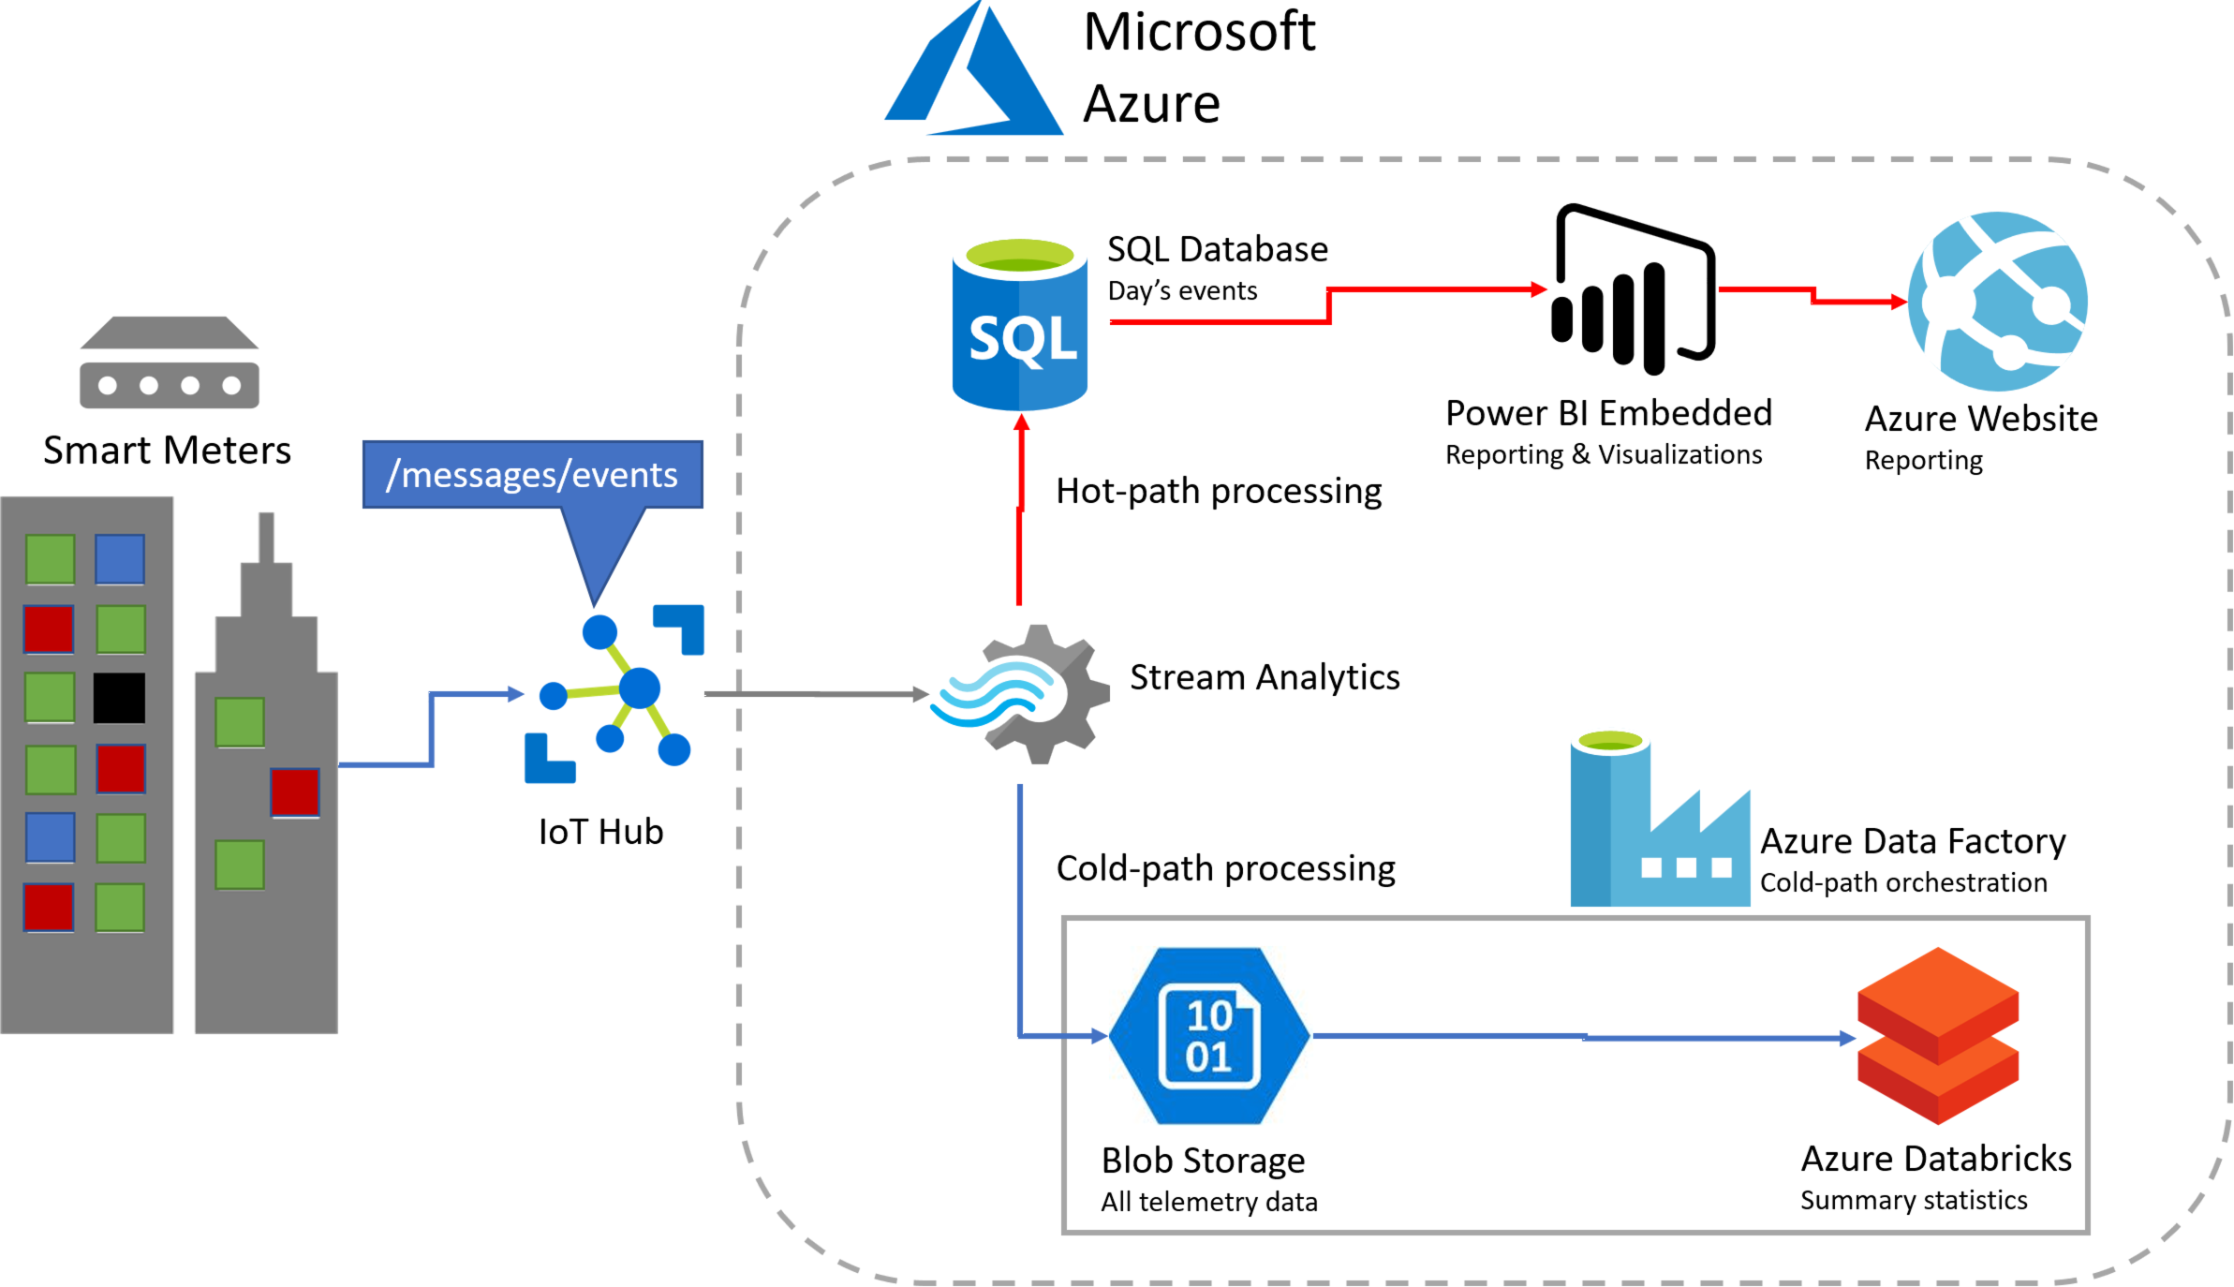
Preferred solution
Notes:
This preferred solution is just one of many viable options
From a high-level:
Messages ingested from Smart Meters via IoT Hub
Stream Analytics job pulls telemetry messages from IoT Hub
Hot path data query selects out event telemetry for real-time reporting on Azure Web App
Cold path data query sends all telemetry to blob storage
Databricks and Spark SQL used to apply the batch computation needed for the reports at scale
Store the query-ready results in SQL Database.

Slide 14
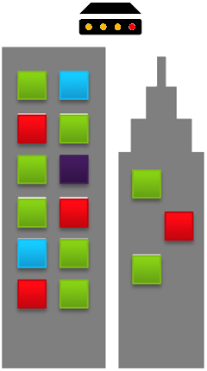
Preferred solution - 2
Device to cloud communication
HTTPS POST, AMQP, AMQP over WebSockets, MQTT, MQTT over WebSockets
3,333 messages/second
Smart Meters
Azure IoT Hub
at S3 scale
Notes:
What is the anticipated volume in messages per second and in MB per second that Fabrikam will need to support given their customer base?
They would need to support 3,333 messages per second and about 0.32 MB per second.
How would you propose they ingest that quantity of messages? What Azure Service would you recommend and why? At what initial scale?
IoT Hub or Event Hubs.
IoT Hub preferred as it provides requested cloud to device support. Would require a single IoT Hub Unit at S3 scale.
Event Hubs designed for this scenario, and can scale to support considerably more than what Fabrikam currently needs. They would need at least 4 TUs to support the 3k+ event/second.
What protocol would they use in sending telemetry from the devices to the service used for ingest?
HTTPS POST, via AMQP, AMQP over WebSockets, MQTT
http(s)://{IoTHubHostName}.azure-devices.net/devices/{deviceId}/events
What is the format of the message sent to your ingest endpoint?
JSON encoded string (HTTP)
Binary (other protocols)

Slide 15
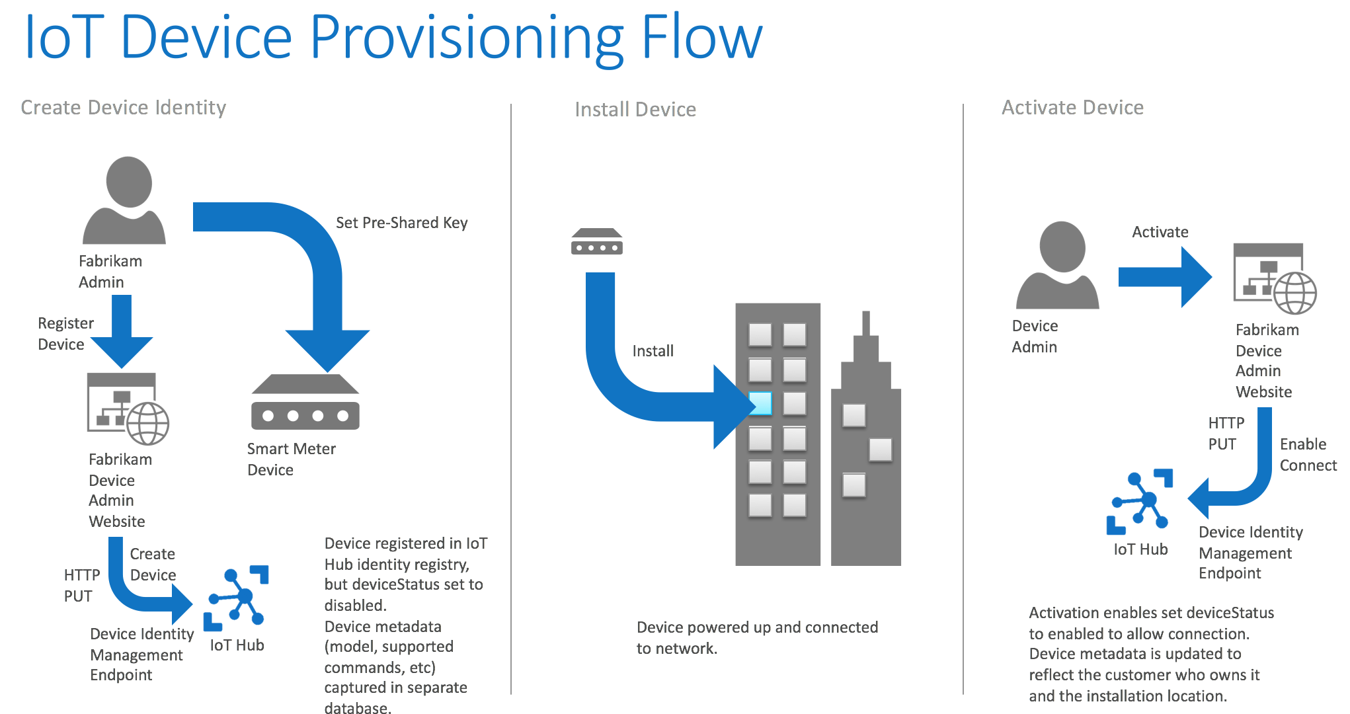
Preferred solution - 3
Device provisioning
Notes:
Keeping the Azure service you selected for ingest of telemetry data from the smart meters in mind, diagram how Fabrikam should handle the following three flows related to the provisioning of new smart meters at a customer site:
Create device identity
Devices should be registered in IoT Hub identity registry, and set to disabled.
Device metadata (model, supported commands, etc.) should be captured in a separate database.
Install device
Devices should be installed, powered up, and connected to the network.
Activate device
Devices set to enabled to allow connection.
Metadata is updated to reflect customer and location.

Slide 16

Preferred solution - 4
Hot path processing
SELECT AVG(EnergyUsed) AS Average, DeviceId
FROM Input1
GROUP BY TumblingWindow(minute, 5), DeviceId
Stream Analytics job
IoT Hub
Smart Meters
Notes:
How would you select out the “hot” data? Choosing between the stream processing options, Azure Stream Analytics and Storm on HDInsight, which would you recommend for this scenario and why?
In this scenario, Azure Stream Analytics and Storm can both perform the necessary window computations and write the output to SQL DB.
A primary consideration is the effort required. In the case of Stream Analytics, Fabrikam need only author a query using the Stream Analytics Query Language, but for Storm, they would need to author a topology and deploy a Java JAR (or a topology built using SCP.NET using C#).
Another is Stream Analytics is restrictive on formats of input data: must be UTF8 encoded JSON/CSV or Avro, must be well formed, no support for custom handling logic, no access to message headers
Other Options: Web Job running EventProcessorHost, HDInsight with Spark Streaming
Explain how you could build the solution using Azure Stream Analytics. What type of window would you use? What does your query look like?
Use a tumbling window with 5 minutes duration. The query would look similar to the following:
SELECT AVG(EnergyUsed) AS Average, DeviceId
FROM Input1
GROUP BY TumblingWindow(minute, 5), DeviceId
Explain how you could build the solution using Azure Stream Analytics. How many streaming units would you need? Explain how you calculated this.
Volume of data flowing thru the Event Hub is ~325KB/s
Only 1 Streaming Unit (which supports up to 1 MB/s) is required
Explain how you could build the solution using Storm on HDInsight.
Provision an HDInsight cluster.
Author a topology project in Java or C# (when using SCP.NET) that uses the EventHubSpout.
Compile and package the project.
Manually submit the project using your cluster’s Storm Dashboard.
Alternately, if developing in Visual Studio using the HDInsight Tools for Visual Studio, right click the project and choose Submit to Storm on HDInsight.
Explain how you could build the solution using Storm on HDInsight. How would you store the “hot” data for consumption by the web dashboard?
If using Stream Analytics -> store the hot data in SQL DB.
If using Storm -> options broaden to SQL DB or HBase, but SQL DB would still be the preferred option because it would require more development for the Web Dashboard to “join” additional data to the telemetry that is used in the reports (such as friendly device names, labels, etc.).
Estimate the write throughput you would require—does your selected store support it?
When averaged to a 5 minute window per device, the write requirement becomes very low ~0.06 MB/s. SQL DB S0 or higher could easily handle this load.

Slide 17


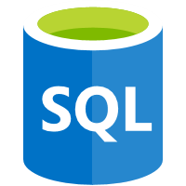
Preferred solution - 5
Cold path processing
Azure Databricks
and Spark SQL
Stream Analytics Job
Cold path query
Blob storage
Azure Data
Factory
telemetry/{year}/{month}/{day}/{hour}/
Azure SQL DB
Notes:
How would you structure the output of blobs from your stream-processing component? Draw an example hierarchy.
One approach is to use a hierarchy with the year at the root, followed month, day, and hour. This structure is interpreted by hive when declaring an external table (so the files within the folder do not need to also contain the year, month, day, and hour data).
year = 2017
month = 12
day = 05
hour = 09
What would you use to query these blob files?
Use Databricks File System (DBFS) if the storage account is mounted in Azure Databricks or use a wasbs path to access the files in blob storage from Databricks, or HiveQL on HDInsight, Spark SQL on HDInsight, or Azure SQL Data Warehouse all of which can read from Azure Storage blobs.
How would you orchestrate the processing and retain visibility into the status of the data flow? How would you configure this data flow? Be specific on what activities you would use.
By using Azure Data Factory (ADF).
In ADF, you would configure a pipeline that has:
An input dataset that is pointing to blob storage (where the telemetry data lives)
An output dataset that writes the data to SQL Database.
The pipeline itself would consist of a single activity, a Hive activity that executes the Hive query previously defined (and stored in blob storage).
An on-demand HDInsight cluster would be used for computation of the Hive query.

Slide 18
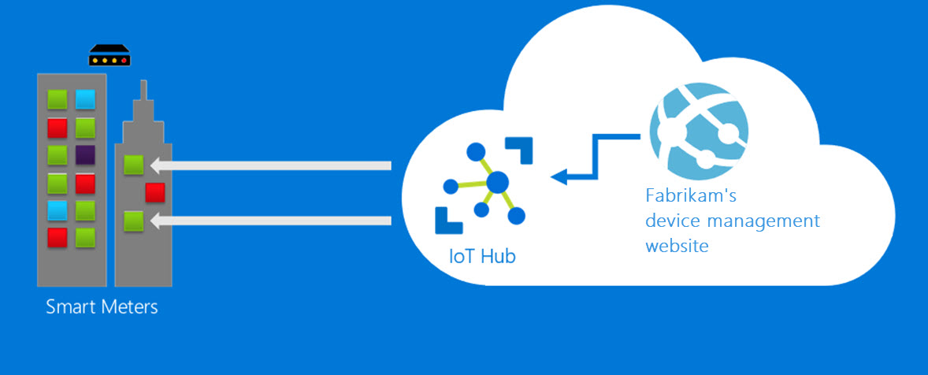
Preferred solution - 6
Cloud to device communication
HTTPS Polling, AMQP, AMQP over WebSockets, MQTT, MQTT over WebSockets
Notes:
Diagram how commands from the Fabrikam device management website would flow to the target device. Be specific and identify endpoints used and protocols selected.
Messages set via the Fabrikam device management website
Messages sent to IoT Hub, specifying target devices
IoT Hub sends messages to devices via MQTT, AMQP, or HTTPS 1.1 Polling

Slide 19
Preferred objections handling
Does Azure offer a time series database?
Can Azure handle our volume of telemetry data?
Does Azure support a lambda architecture?
Are Azure IoT Solution Accelerators a good starting point?
Notes:
We are considering an out-of-the-box time series database solution. Are there options for this on Azure?
There are two primary options you can select, depending on the level of flexibility you desire. The first option is a hosted Azure service that does not require any software installation or server management, called Time Series Insights. It is built to ingest massive amounts of time series data, specifically IoT devices. You can use it to quickly create filters, build reports, and also import from more than one source so you can compare the data in one location.
Another option for hosting a times series database in Azure is Open TSDB, which leverages HBase, and is supported as a service that is a part of Azure HDInsight.
We have a mix of large enterprise customers and many SMB customers, which adds up to a lot of telemetry data to ingest—can Azure really handle it?
Event Hubs is designed for massive scale of streaming message ingest.
Example: it can handle 1 billion events per day, and that’s just at a scale of 12 TU which costs ~$264/mo. You can scale to 20 TUs on your own, or more if you call Microsoft to increase your quota.
Can Azure handle a lambda architecture?
Yes.
There are a variety of services in Azure that can be used in combination according to the customer requirements to accomplish the batch or streaming ingest, the hot and cold paths of processing (both stream and batch), transactional, and write-once-read-many storage and data pipelining.
Many services overlap in their capability to meet the needs of the lambda architecture-- it is important to take the time to create a project plan that educates the customer with the Azure options in the analytics pipeline and identifies why specific services were recommended for the final solution.
We have heard of Azure IoT Solution Accelerators – do these offer a good starting point for us?
Azure IoT Solution Accelerators offer preconfigured solutions that automate the provisioning and configuration of scenario oriented solutions that leverage a combination of Azure services.
The idea is that a customer can take the preconfigured solution deployed by one of the Azure IoT Solution Accelerators and customize it to meet their particular needs.
The Remote Monitoring IoT Solution Accelerator provides a solution that is reasonably close to the needs of Fabrikam albeit some additional work is needed to handle the cold path processing, to leverage Spark, or to use Azure SQL Data Warehouse.

Slide 20
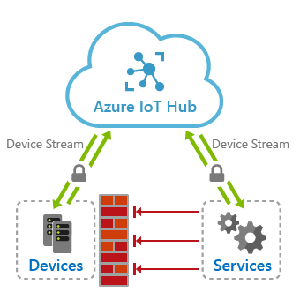
Customer objections - Review
Some of our customers require their IoT devices to communicate in a firewall-friendly way without opening up additional incoming or outgoing ports. How do we accomplish this?
Notes:
Some of our customers require their IoT devices to communicate in a firewall-friendly way without opening up additional incoming or outgoing ports. What options do we have to accomplish this?
It is common for companies to install their IoT devices behind a firewall within private, isolated networks. Oftentimes, the firewalls that are installed on the edge of the network are configured to block incoming communications, including the type used to send commands to the devices over the internet. Since one of the solution requirements is to enable cloud-to-device communication, we need a secure, firewall-friendly way to communicate between these isolated networks and the public internet.
Azure IoT Hub Device Streams allow us to use the outbound connection that is already established for the devices to communicate with IoT Hub, and enable that connection to also receive inbound connections from the cloud to these devices. In this way, IoT Hub acts as a proxy between the devices and external services that are otherwise blocked from direct communications through the firewall. With Device Streams, only the outbound port 443 is used. You do not need to open any inbound ports on the device or its network. To ensure secure communication between devices and services, or applications, IoT Hub Device Streams enforces authentication by requiring the devices and services communicating with them to authenticate using their IoT Hub credentials. All traffic sent over a device stream is always encrypted using TLS, regardless of whether the application sending communication encrypts its messages. Another benefit to using Device Streams is that the streams are fully compatible with the TCP/IP stack. This makes it easy to integrate into proprietary device applications or off-the-shelf TCP/IP applications such as SSH/RDP, web, file transfer, etc.
The Device Stream workflow is as follows:
- The device and external service both authenticate with IoT Hub. IoT Hub then provides both the device and service with an authentication token to a streaming endpoint.
- The device and service create WebSocket clients using the authentication token. Reliability and ordering of messages on par with TCP. All communications encrypted over WebSocket's TLS channel.
- The service initially connects to the device by name, not IP.
- The device can decide whether to accept the connection.
- The service is notified of the result of device accepting the stream and proceeds to create its own WebSocket client to the streaming endpoint. Similarly, it receives the streaming endpoint URL and authentication information from IoT Hub.
- This workflow happens transparently, reducing or eliminating additional code on both the device and service side.

Slide 21
Customer quote
“With Azure, we can support tremendous volumes of data, while not giving up our ability to manage and monitor the processes behind it.”
- Sam George, Director of Analytics, Fabrikam

